Slide 1

JSP (Java Server Pages)
Embedding Java in HTML
WebAppContext
JSP Mechanics

Slide 2

See Also
http://www.jsptut.com/
http://www.tutorialspoint.com/jsp/
Notes:
Some additional information on concurrency

Slide 3
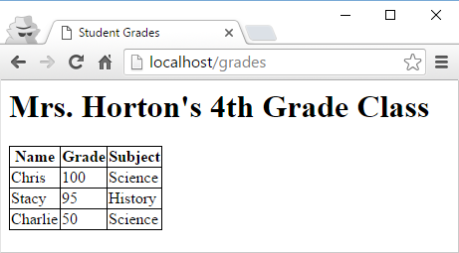
HTML in Java
response.setContentType("text/html");
response.setStatus(HttpServletResponse.SC_OK);
PrintWriter pw = response.getWriter();
pw.println("<html><head><title>Student Grades</title></head>");
pw.println("<style>th, tr, td, table {border: 1px solid black;"+
"border-collapse: collapse;}</style><body>");
pw.println("<h1>"+HortonData.TEACHER+"'s 4th Grade Class</h1>");
pw.println("<table><tr><th>Name</th><th>Grade</th><th>Subject</th></tr>");
for(int i=0;i<HortonData.SAMPLE_DATA.length;++i) {
pw.println("<tr><td>"+HortonData.SAMPLE_DATA[i][0]+"</td>");
pw.println("<td>"+HortonData.SAMPLE_DATA[i][1]+"</td>");
pw.println("<td>"+HortonData.SAMPLE_DATA[i][2]+"</td></tr>");
}
pw.println("</table><p></body></html>");
Streams of bytes … two ways (into your program and out of your program)
Disks, consoles, sockets, keyboards, printers
Know how to talk streams and you can talk to anything
Initialization (constructor) is different. Use is the same.

Slide 4
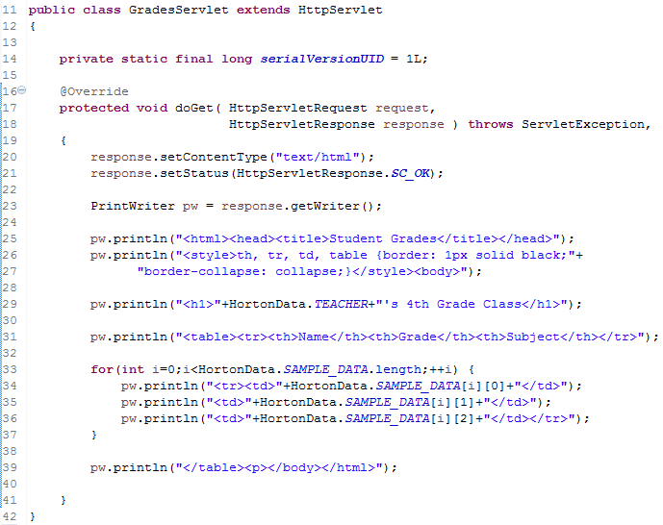
HTML in Java
Streams of bytes … two ways (into your program and out of your program)
Disks, consoles, sockets, keyboards, printers
Know how to talk streams and you can talk to anything
Initialization (constructor) is different. Use is the same.

Slide 5
Java in HTML
grades.jsp
<%@ page import="web.HortonData" %>
<html>
<head>
<title>Student Grades</title>
</head>
<style>
th, tr, td, table {
border: 1px solid black;
border-collapse: collapse;
}
</style>
<body>
<h1><%= HortonData.TEACHER %>'s 4th Grade Class</h1>
<table>
<tr>
<th>Name</th><th>Grade</th><th>Subject</th>
</tr>
<% for(int i=0;i<HortonData.SAMPLE_DATA.length;++i) { %>
<tr>
<td><%=HortonData.SAMPLE_DATA[i][0] %></td>
<td><%=HortonData.SAMPLE_DATA[i][1] %></td>
<td><%=HortonData.SAMPLE_DATA[i][2] %></td>
</tr>
<% } %>
</table>
</body>
</html>
Streams of bytes … two ways (into your program and out of your program)
Disks, consoles, sockets, keyboards, printers
Know how to talk streams and you can talk to anything
Initialization (constructor) is different. Use is the same.

Slide 6
JSP
Allows you to put Java inside HTML
The server generates the servlet code for you the first time it is called
Servlet is cached for later calls
Mostly HTML with a little Java: Use JSP
Mostly Java with little or no HTML: Use Servlet
Single Page Applications and AJAX applications that fetch data are making JSP obsolete.
JSF (Java Server Faces) has mostly replaced JSP. JSF integrates easily with AJAX.
Streams of bytes … two ways (into your program and out of your program)
Disks, consoles, sockets, keyboards, printers
Know how to talk streams and you can talk to anything
Initialization (constructor) is different. Use is the same.

Slide 7
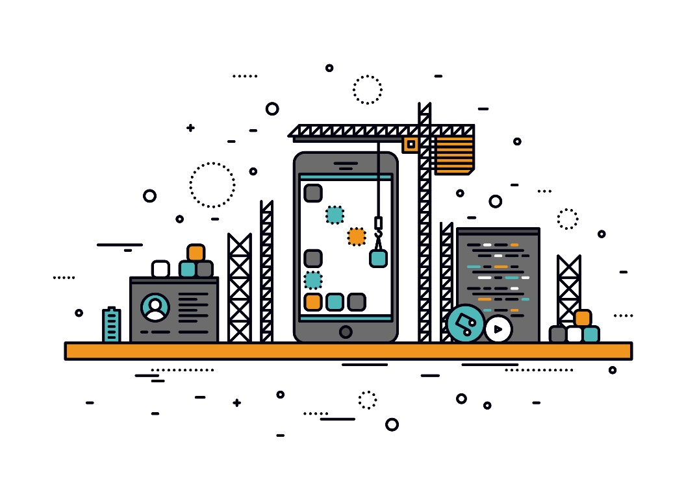
Jetty WebAppContext
Allows you to use a standard WEB-INF/web.xml setup
You can still embed the server
You can configure the WEB-INF manually for development
Streams of bytes … two ways (into your program and out of your program)
Disks, consoles, sockets, keyboards, printers
Know how to talk streams and you can talk to anything
Initialization (constructor) is different. Use is the same.

Slide 8
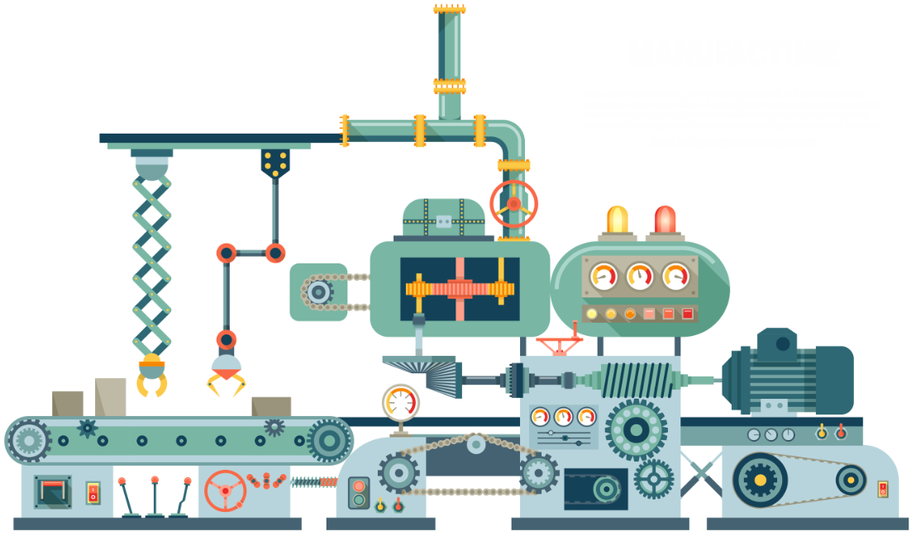
WebAppContext
public static void main(String[] args) throws Exception {
Server server = new Server(80);
WebAppContext context = new WebAppContext();
context.setContextPath("/"); // URLs for this context start here
context.setResourceBase("webroot"); // Files for this context start here
// Needed by the Jasper JSP engine
context.setAttribute(InstanceManager.class.getName(), new SimpleInstanceManager());
context.addServlet(HelloServlet.class, "/hello");
// Link the server to the context
server.setHandler(context);
// Needed by the Jasper JSP engine
new JettyJasperInitializer();
// Start the server thread
server.start();
}
Streams of bytes … two ways (into your program and out of your program)
Disks, consoles, sockets, keyboards, printers
Know how to talk streams and you can talk to anything
Initialization (constructor) is different. Use is the same.

Slide 9

JSP Mechanics
Element | Description
<%@ page … %> | Page-dependent attributes (imports)
<% … %> | Java code
<%! … %> | Variable or method declaration (non-local)
<%= … %> | Value to insert into page
Java Object | Description
out | JspWriter
request | HttpServletRequest
response | HttpServletResponse
Streams of bytes … two ways (into your program and out of your program)
Disks, consoles, sockets, keyboards, printers
Know how to talk streams and you can talk to anything
Initialization (constructor) is different. Use is the same.

Slide 10
Live Demo

Slide 11
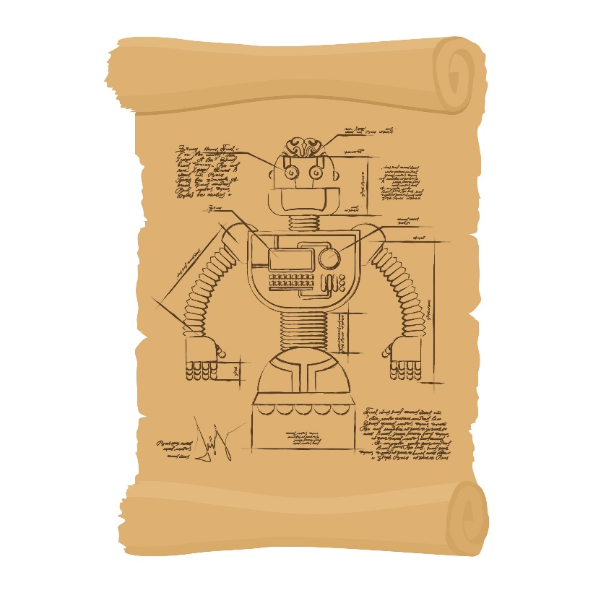
Tinkering
Type in the “grades” JSP example.
Change the code to print separate tables for each subject (like “History” and “Science”).
Add some more data points to the sample data.

